Slide 1



Introduction to R and RStudio
Session 9: Ongoing learning

Slide 2
Ongoing Learning
Learning R is not unlike learning a spoken language:
Unfortunately it takes time to build vocab and learn syntax.
Regular (even total) immersion is the best way to progress.
Will reward you if you can make the investment

Slide 3
Quick fix

Slide 4
What if you get stuck? Google (Stack Overflow) Strategy

Slide 5
Stack Overflow Strategy
Require vocabulary to describe the problem
(which you may not have right away)
There is more than one style of writing R!
Best to find the style that you’re already using.
Beware the date of answer.

Slide 6
Stack Overflow Strategy
Example:
https://stackoverflow.com/questions/8212699/group-by-multiple-columns-and-sum-other-multiple-columns

Slide 7
Longer term fixes

Slide 8

O ngoing Learning
http://r4ds.had.co.nz/

Slide 9

Ongoing Learning
www.moderndive.com

Slide 10
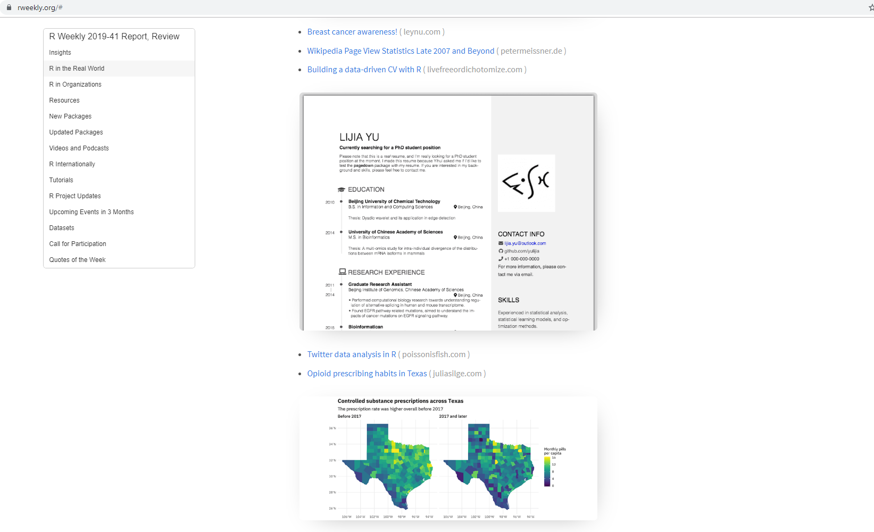
https://rweekly.org/

Slide 11
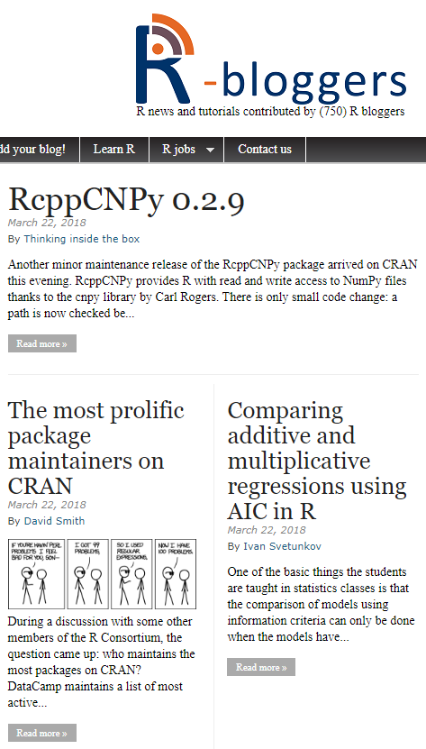
https://www.r-bloggers.com/

Slide 12
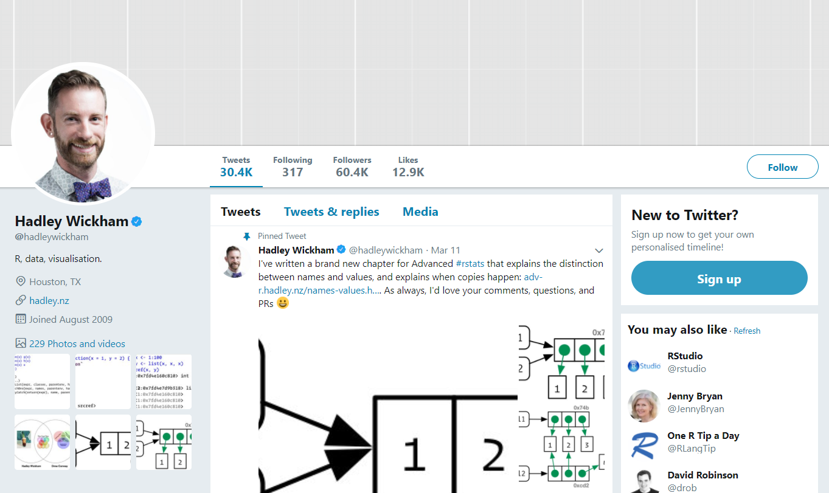
Twitter

Slide 13
This material was created for the NHS-R community by:
Andrew Jones @The Strategy Unit
The work is licenced under:
Creative Commons
Attribution-ShareAlike 4.0
International
To view a copy of this license, visit
https://creativecommons.org/licenses/by-sa/4.0/

Slide 14
End

